Slide 1
Docker

Slide 2
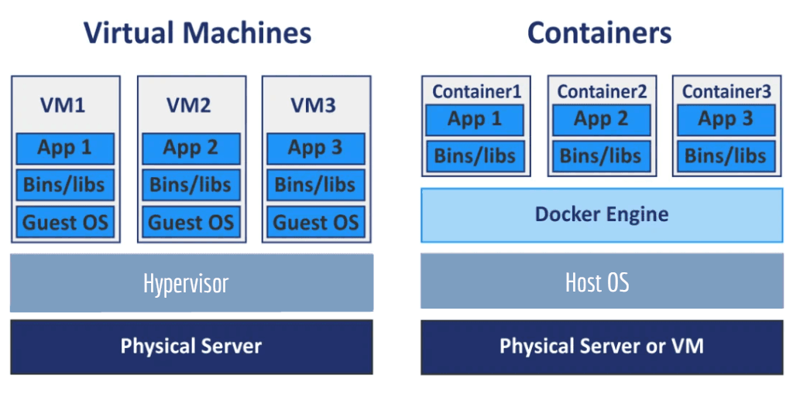

Slide 3
